Slide 1
Modeling instead of test cases
Saying more with less

Slide 2
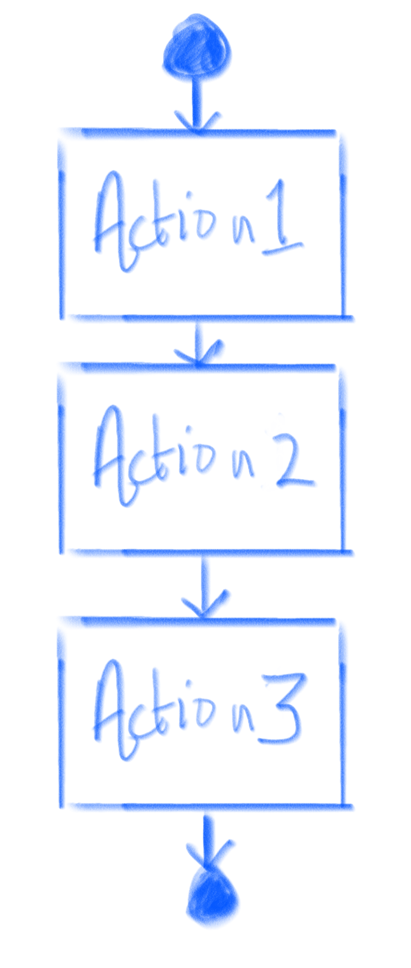
How many test cases is this?
Answer: 1 case that goes…
1. Action 1
2. Action 2
3. Action 3

Slide 3
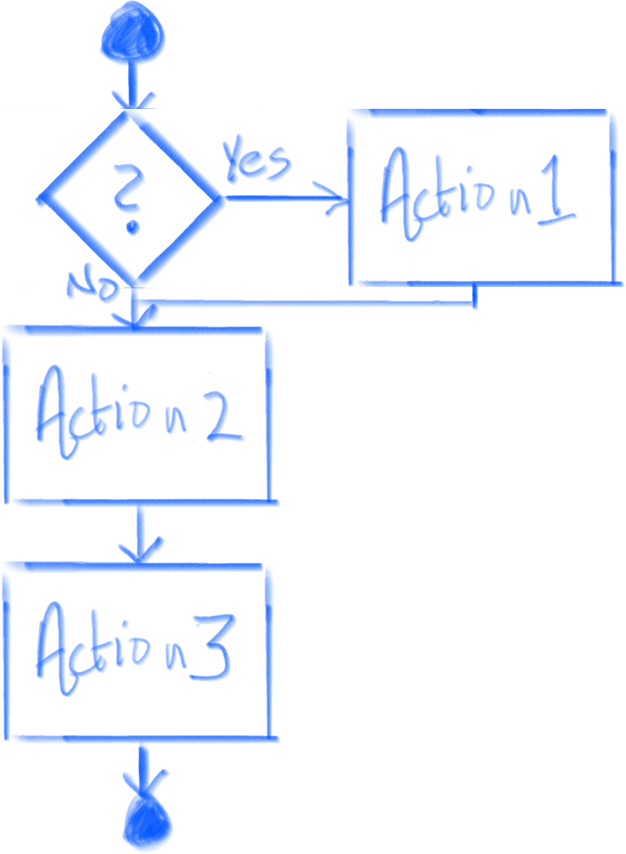
How many test cases is this?
Answer: 2 cases
One where the user chooses “yes” on first decision, and one where the user chooses “no” on the first decision.

Slide 4
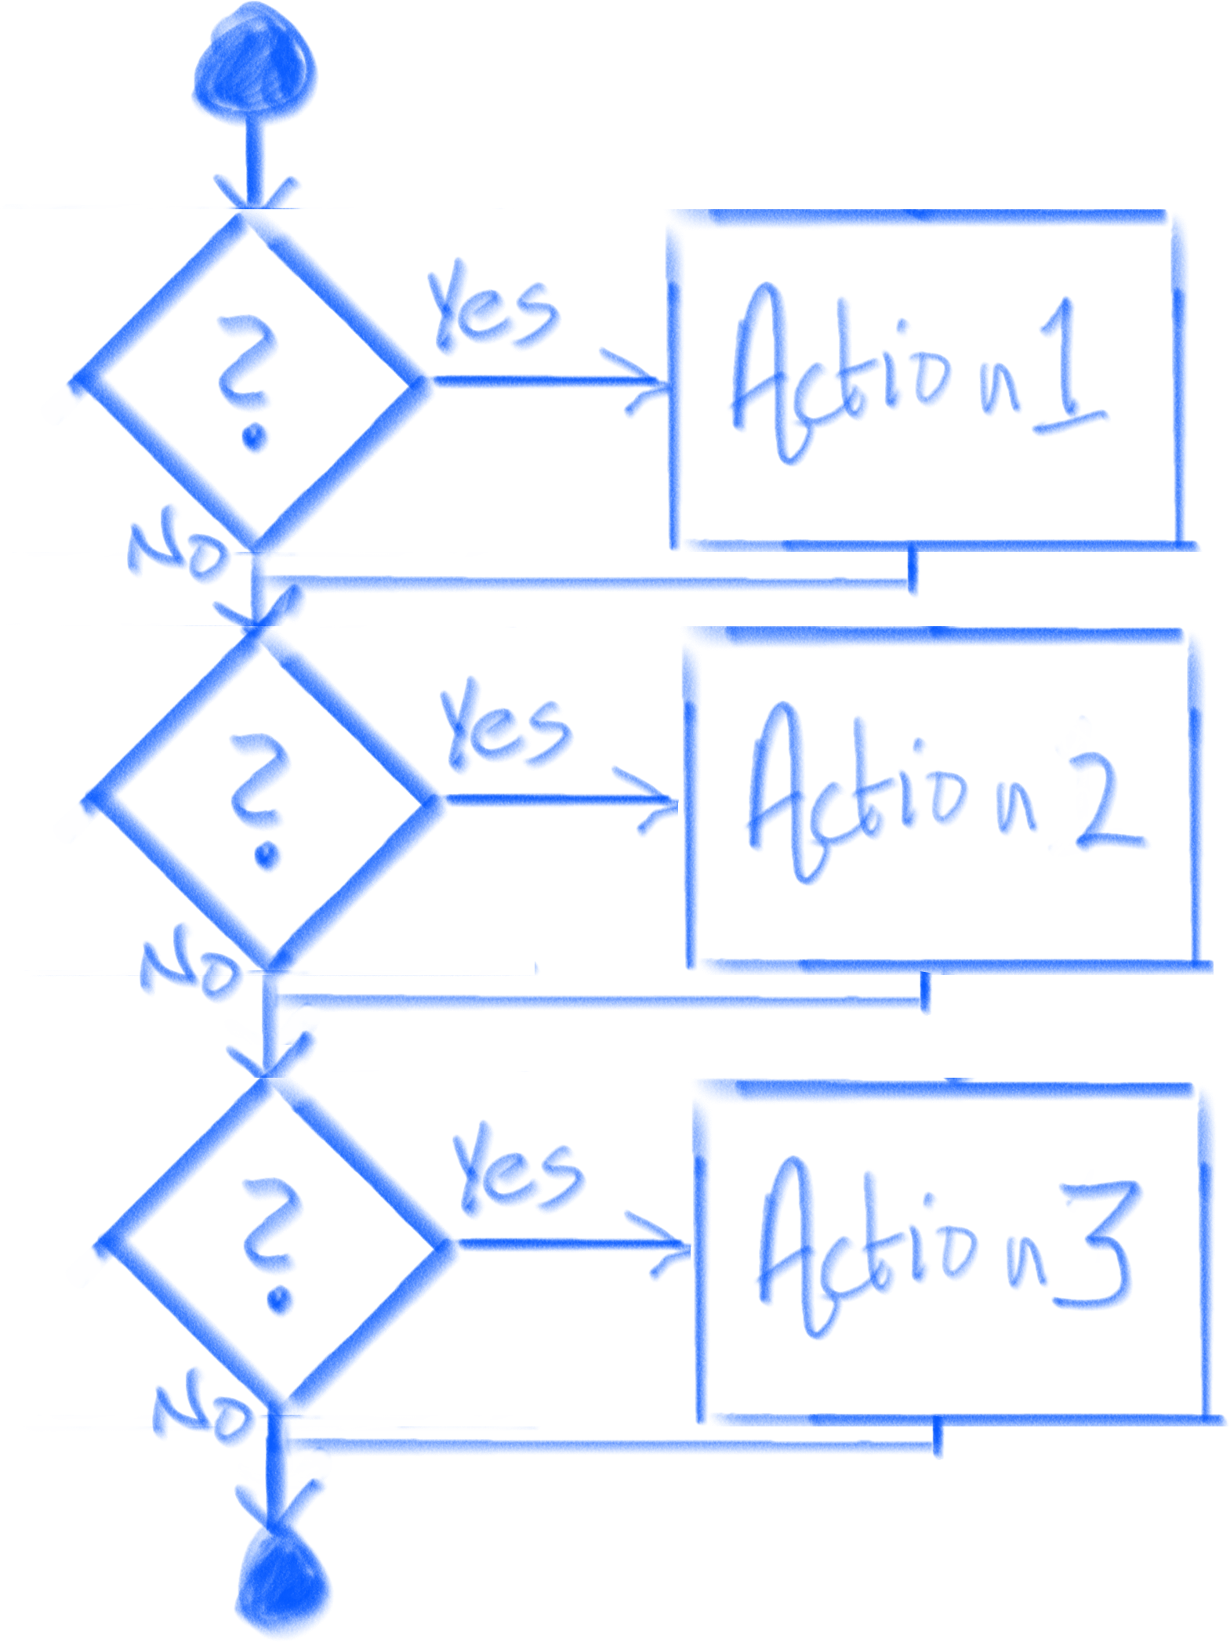
How many test cases is this?
Answer: Eight cases, three yes/no decisions, which gives us 2^3 = 8 cases

Slide 5
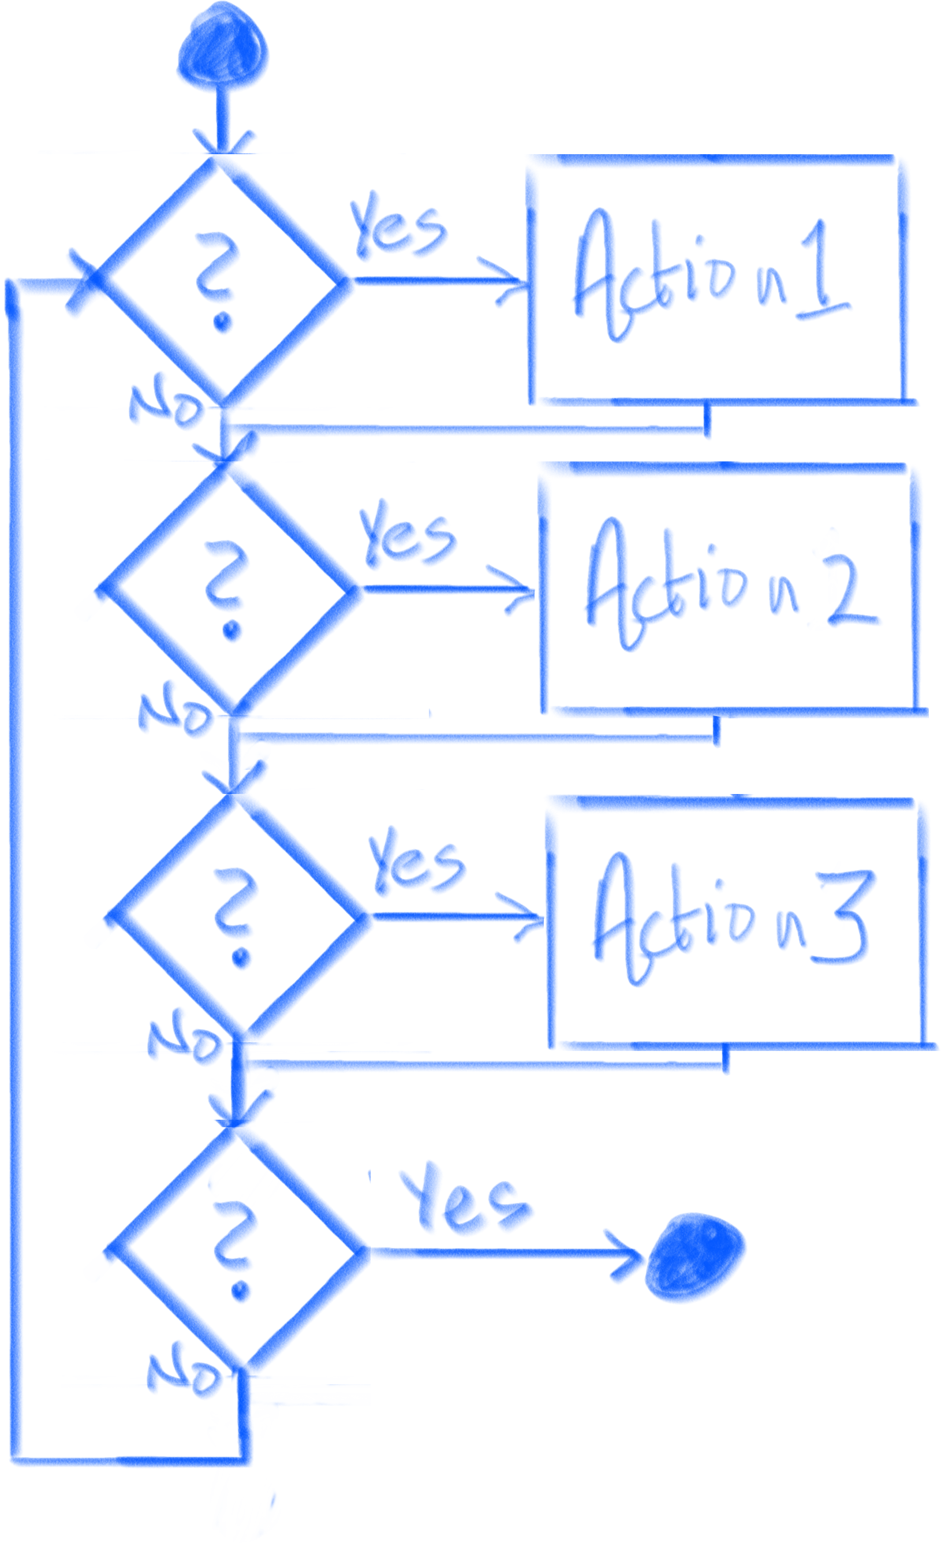
How many test cases is this?
Answer: Infinity, where the number of cases grows by 2^(n*3) for every iteration of the loop.

Slide 6
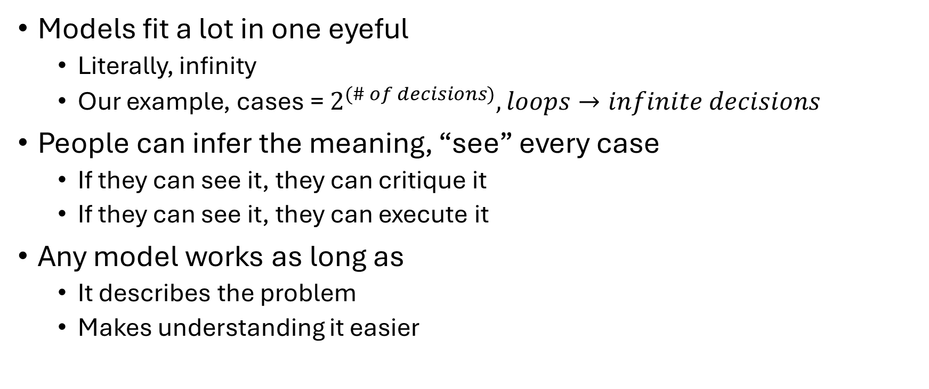
What we learned
Models fit a lot in one eyeful
Literally, infinity
Our example, cases = $2^{(\# of decisions)}, loops→infinite decisions$
People can infer the meaning, “see” every case
If they can see it, they can critique it
If they can see it, they can execute it
Any model works as long as
It describes the problem
Makes understanding it easier

